Slide 1

FLIGHT TICKET PRICE PREDICTION

Slide 2
PROBLEM STATEMENT
Flight ticket prices can be something hard to guess, today we might see a price, check out the price of the same flight tomorrow, it will be a different story. We might have often heard travellers saying that flight ticket prices are so unpredictable. As data scientists, we are going to prove that given the right data anything can be predicted

Slide 3
ROADMAP OF THE PROJECT
Frame the model
Understanding of data
Extract features
Model and analyze
Present result and deploy the code

Slide 4
UNDERSTANDING THE DATASET
TRAIN DATA
TEST DATA
No. of features-10
Label- Price
No. of rows-10683
Data is a mixture of numerical and categorical features
No. of features-10
No. of rows- 2671
Data is a mixture of numerical and categorical features

Slide 5
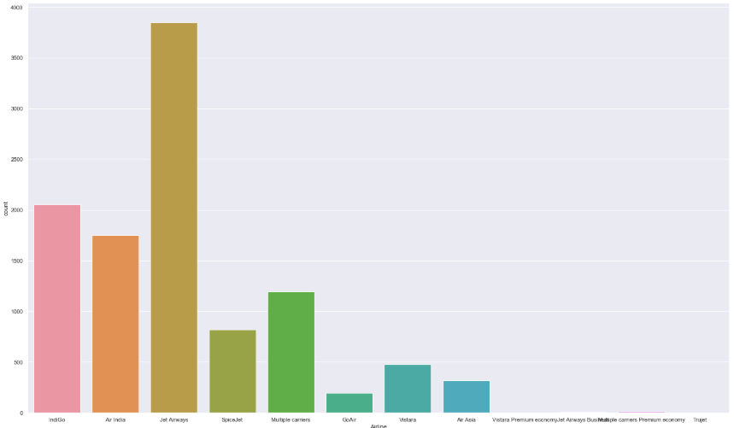
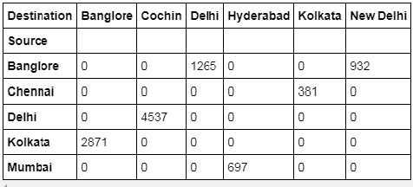
INSIGHT OF DATA
Max flight are of ‘Jet Airways’
The busiest route is from ‘Delhi’ to ‘Cochin’

Slide 6
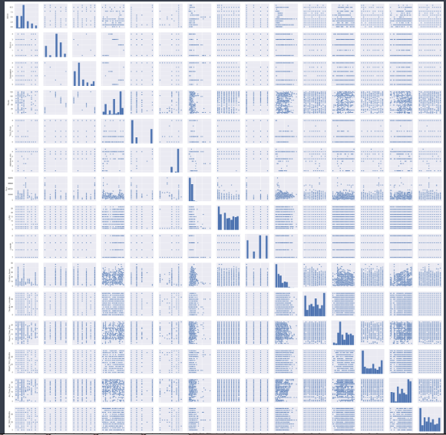
Pair plot – Visualizing the relation between each variables of training data

Slide 7
Feature Selection and Engineering
Training data is combination of both categorical and numerical also we can see some special character also being used because of which we have to do data transformation on it before applying it to our model
Missing values handled
The test data is similar to the training data set, except the ‘Price’ column (To be predicted using the model).
Feature generation of Date_of_journey, Arr_Time,Dep_Time,Duration etc.
Prepare categorical variables for model using label encoder as Number of stops.
Training data is spitted into train and test into 7:3 ratio.

Slide 8
ML MODELLLING Various ML algorithm are used to find the best model
ML MODEL | SCORE
Linear Regression | 0.42
Lasso | 0.42
Ridge | 0.42
Ada Boost Regressor | 0.41
SVR | 0.34
Random Forest Regressor | 0.97
Random Forest Regressor(using cv) | 0.96
Gradient Boosting Regressor | 0.84
Implemented Randomized search on hyper parameters (using Randomized SearchCV) to avoid over fitting and get the best hyper parameter
The best model is Random Forest Regressor with score of 0.97 with Test Split method and 0.96 with randomized search CV method.

Slide 9
THANK YOU

